Slide 1


Renton Fish and Game Club
USPSA
Oktober 2022
Trigger Treat
Match Booklet
Match Director: Marcel Englmaier
Range Master: Eric Beerbaum
Stats: Marcel Englmaier
Stages: Jordan Rogers
Round Count: 146

Slide 2

Stage 1 An L By Any Other Name Course Designer: Marcel Englmaier
An L By Any Other Name is a 21 round, 105 point Comstock Long course. There are 9 USPSA targets and 3 steel targets. The best two hits per target will score. Steel must fall to score. The start signal is audible.
The Handgun start position is standing with toes touching Xs and wrists below belt. Handgun is loaded and holstered. The PCC start position is standing with toes touching Xs and PCC loaded with stock touching belt.
On the audible start signal, engage targets from within the shooting area.

Slide 3
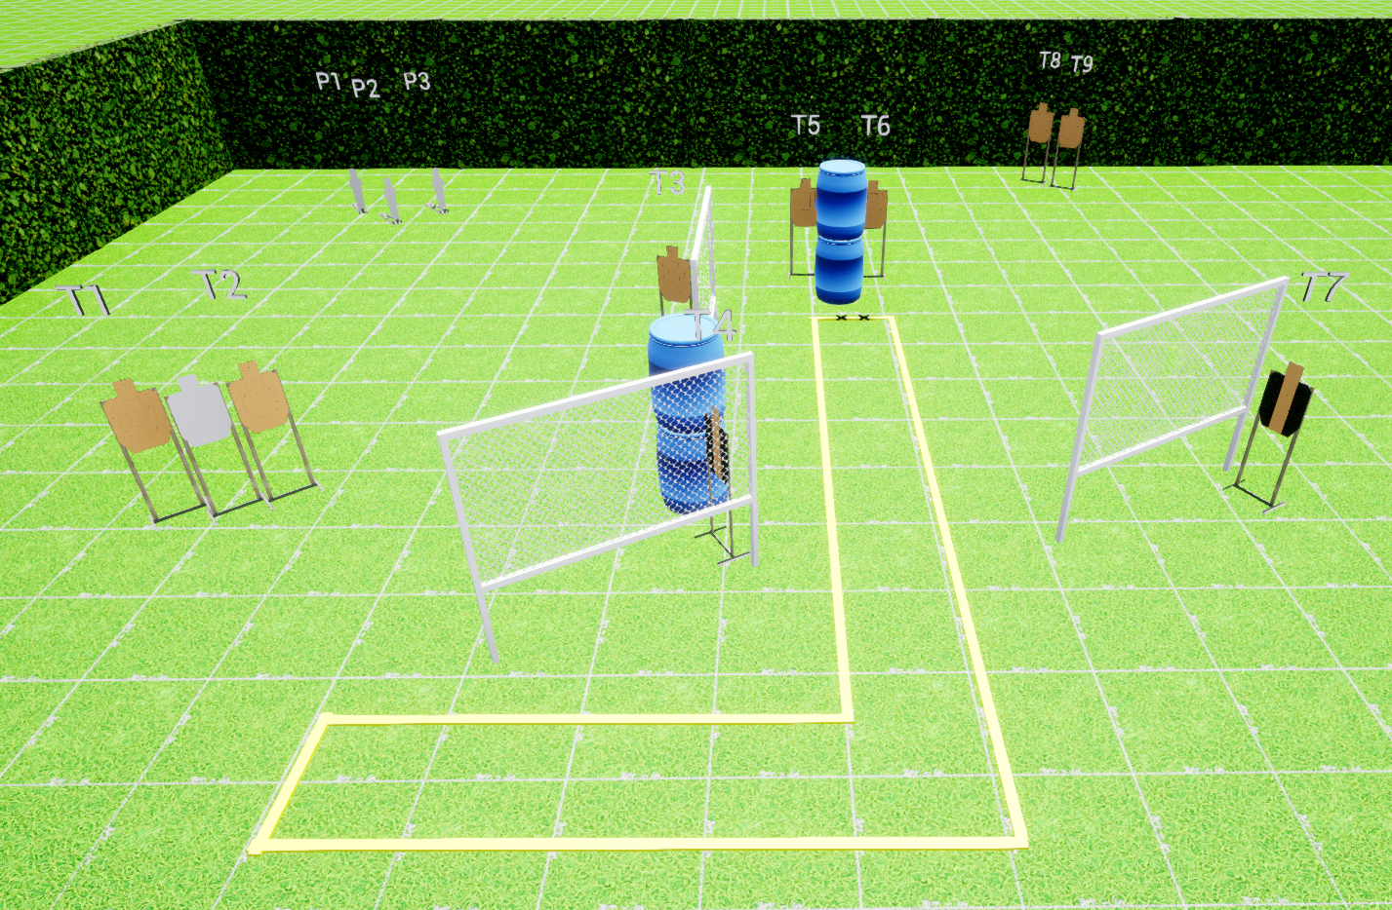
 | Stage 1 An L By Any Other Name Course Designer: Marcel Englmaier

Slide 4

Stage 2 Ode To The Mailman Course Designer: Jordan Rogers
Ode To The Mailman is a 12 round, 60 point fixed time standards exercise. There are three USPSA targets. The best four hits per target will score. The start and stop signal are audible. The time allowed for each string is 4 seconds.
Start Position String 1: Standing in Box A. Handgun loaded and holstered with wrists below belt. PCC loaded, stock on belt, muzzle pointing downrange. String 2: Kneeling with both knees on ground in Box B. Handgun loaded and holstered with wrists above shoulders. PCC loaded with wrists above shoulders.
Stage Procedure String 1: On the audible start signal engage T1 and T3 with two rounds each freestyle then perform a mandatory reload and engage T2 with two rounds STRONG HAND/SIDE ONLY. String 2: On the audible start signal engage T2 with two rounds then perform a mandatory reload and engage T1 and T3 with two rounds each.

Slide 5
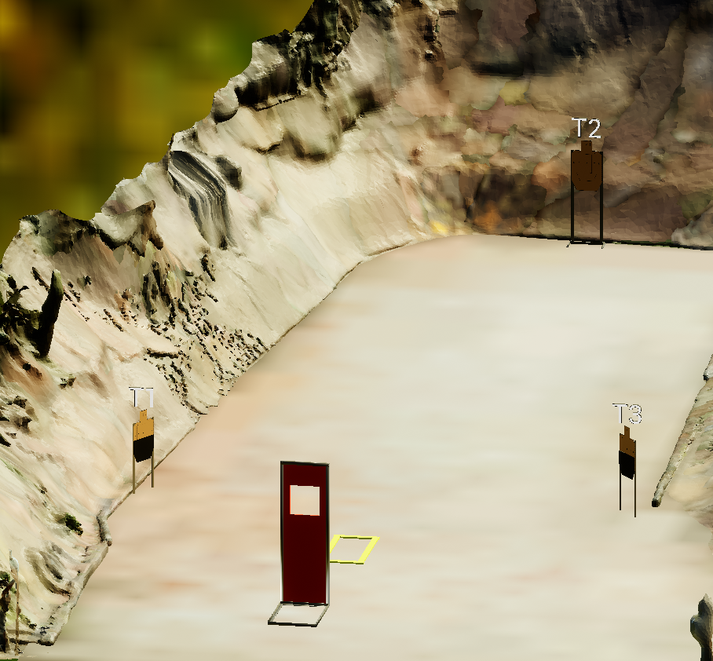
 | Stage 2 Ode To The Mailman Course Designer: Jordan Rogers

Slide 6
Stage 3 Accuracy is Incidental Course Designer: Eric Beerbaum
Accuracy is Incidental is a 26 round, 130 point Comstock medium course. There are 12 USPSA targets and 2 steel targets. The best two hits per paper target will score, steel must fall to score. The start signal is audible.
The Handgun start position is standing outside the shooting area with heels touching box A. Handgun is loaded and holstered with wrists below belt. The PCC start position is standing outside the shooting area with heels touching box A. PCC loaded with stock touching belt
On the audible start signal, engage targets from within shooting areas.

Slide 7
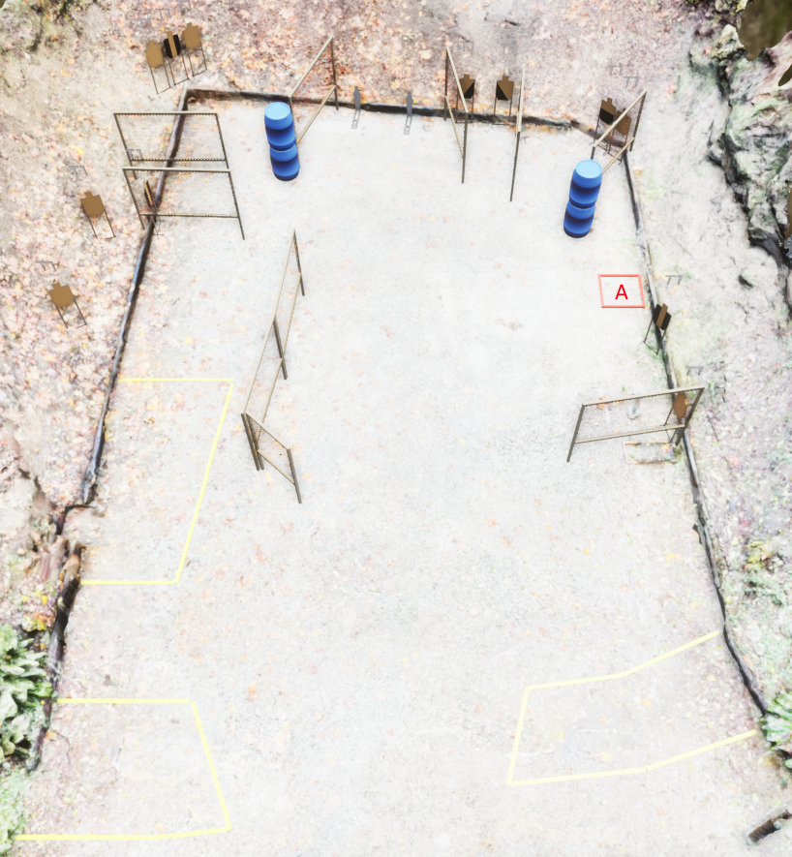
 | Stage 3 Accuracy is Incidental Course Designer: Eric Beerbaum

Slide 8
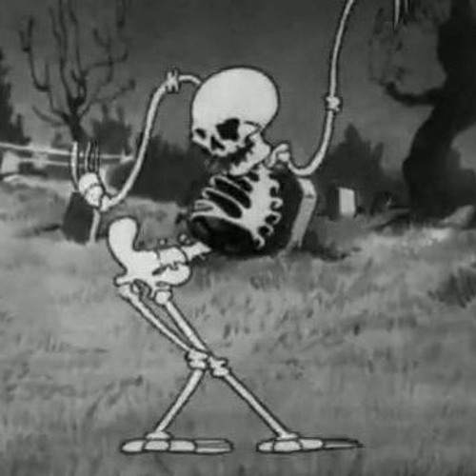
Stage 4 Slot Machines Course Designer: Jordan Rogers
Slot Machines is a 27 round, 135 point Comstock long course. There are 12 USPSA targets and 3 steel targets. The best two hits per target will score. Steel must fall to score. The start signal is audible.
The Handgun start position is standing inside any shooting area with heels touching any fault line. Handgun loaded and holstered and wrists below belt. The PCC start position is standing inside any shooting area with heels touching any fault line. PCC loaded and stock touching belt.
On the audible start signal, engage targets from within the shooting areas.

Slide 9
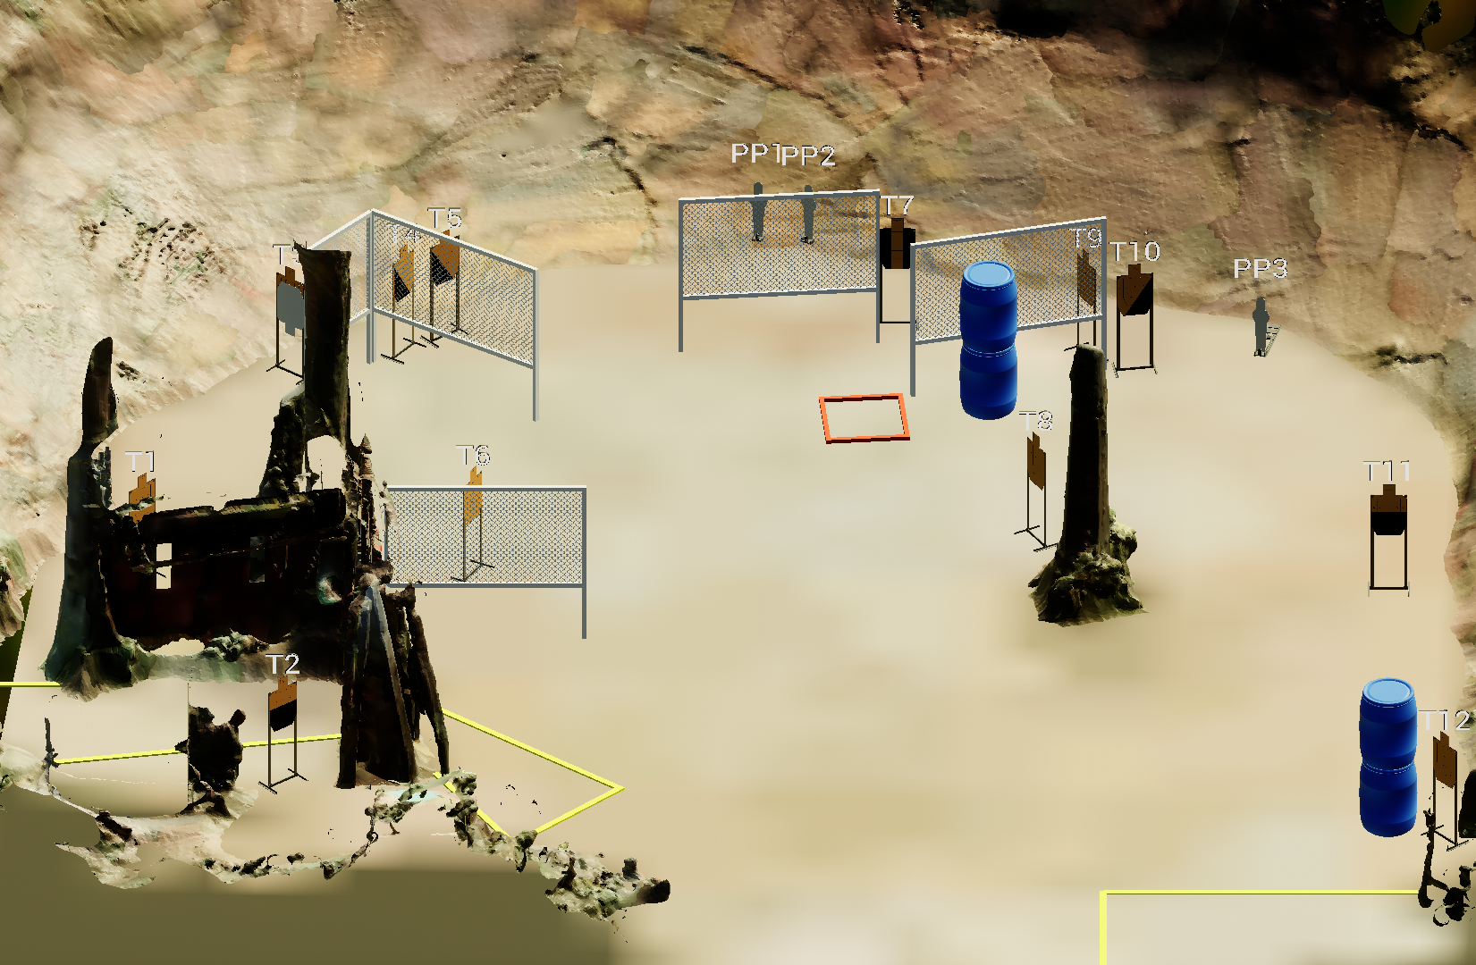
 | Stage 4 Slot Machines Course Designer: Jordan Rogers

Slide 10
Stage 5: CM 03-05

Slide 11
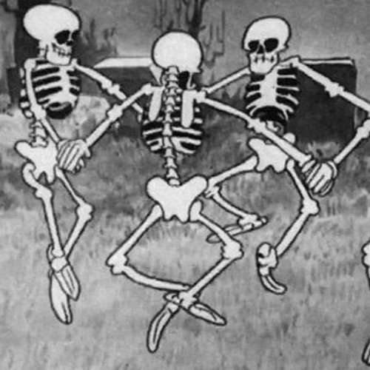
Stage 6 Me Frosted Lucky Charms Course Designer: Eric Beerbaum
Me Frosted Lucky Charms is a 19 round, 95 point Comstock medium course. There are 8 USPSA targets and 3 poppers. The best two hits per target will score. The start signal is audible
The Handgun start position is standing facing downrange with toes touching Xs and wrists below belt. Handgun is loaded and holstered The PCC start position is standing facing downrange with toes touching Xs and PCC loaded with stock touching belt.
On the audible start signal, engage targets from within the shooting areas.

Slide 12
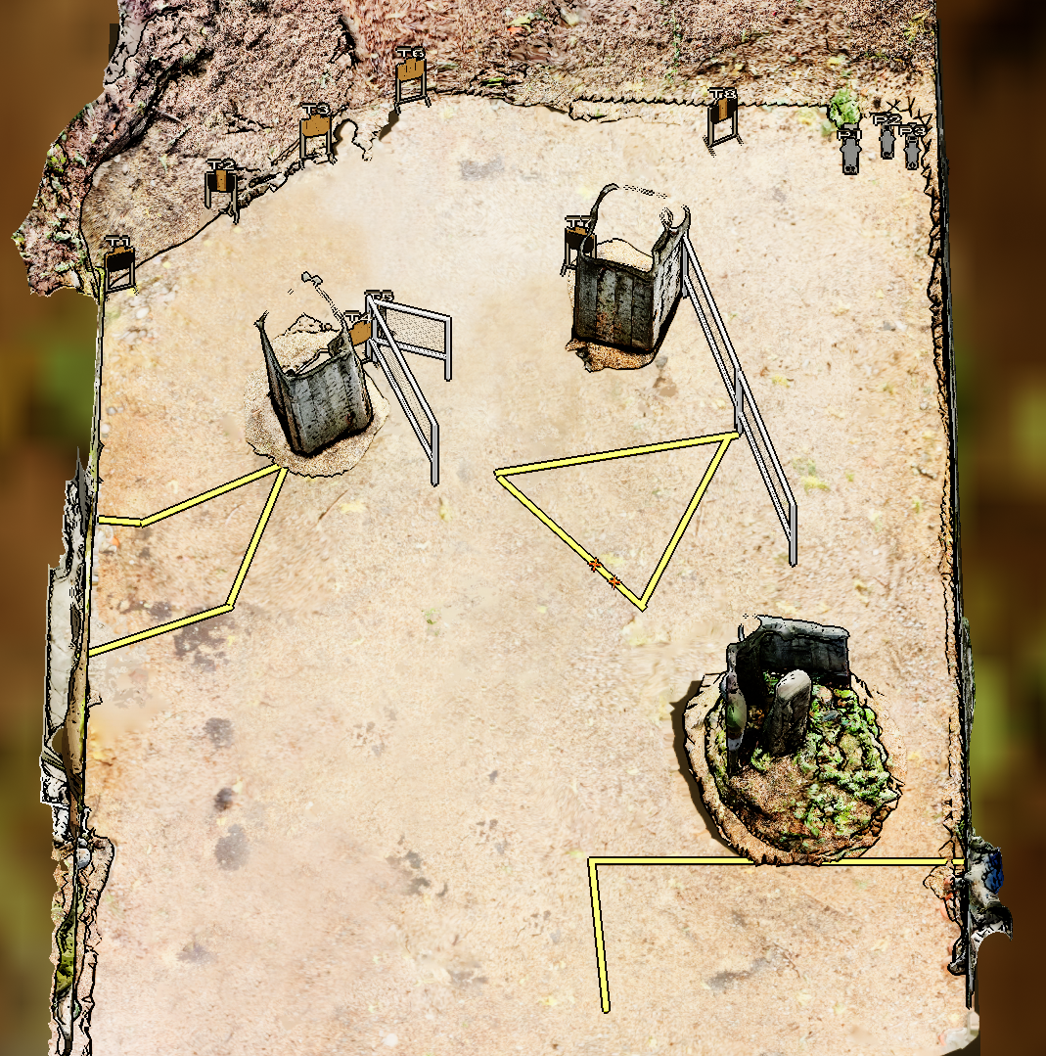
 | Stage 6 Me Frosted Lucky Charms Course Designer: Eric Beerbaum

Slide 13
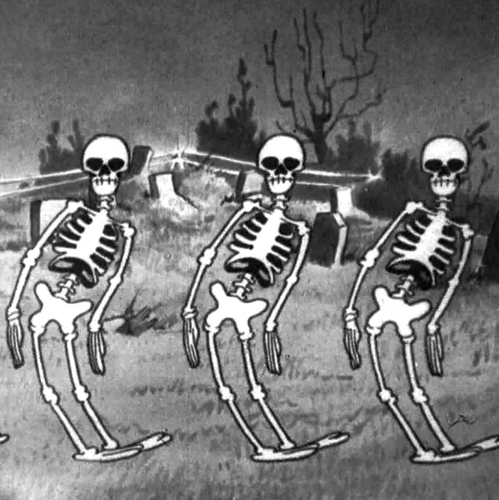
Stage 7 Always Has Been Course Designer: Jordan Rogers
Always Has Been is a 31 round, 155 point Comstock long course. There are 12 USPSA targets and 7 steel targets. The best two hits per target will score. Steel must fall to score. The start signal is audible.
The Handgun start position is standing outside the shooting areas with toes touching any fault line. Handgun loaded and holstered and wrists below belt. The PCC start position is standing outside the shooting area with toes touching any fault line. PCC loaded and stock touching belt.
On the audible start signal, engage targets from within the shooting areas.

Slide 14
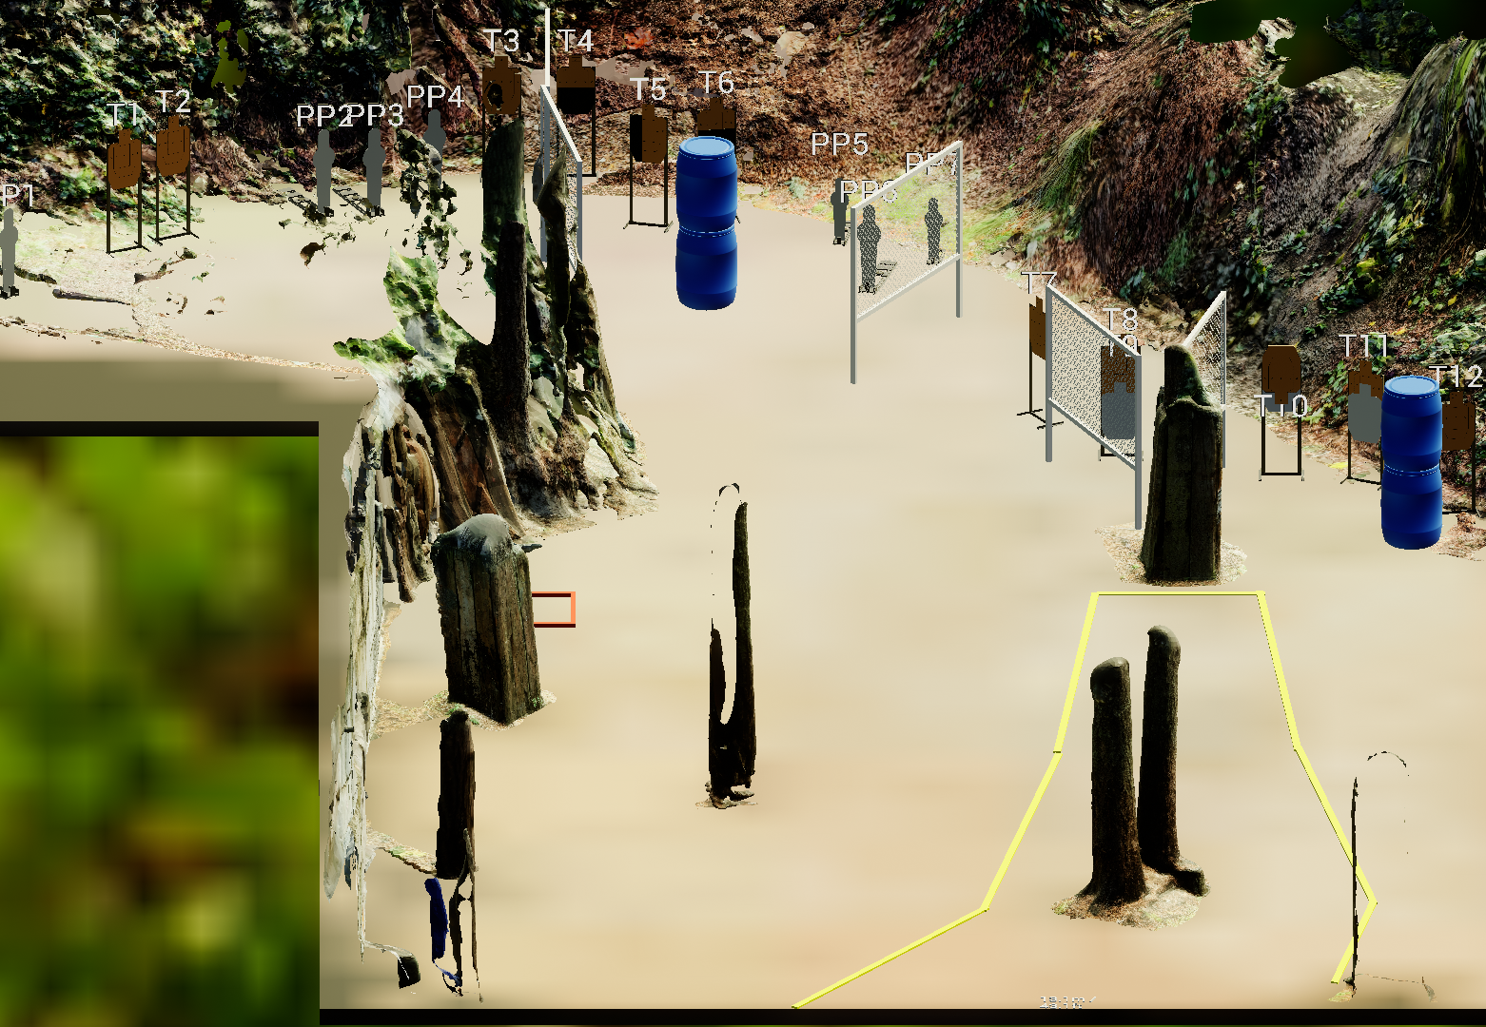
 | Stage 7 Always Has Been Course Designer: Jordan Rogers

